Slide 1
Single Source Shortest Path
Section 6.3

Slide 2
Single Source Shortest Path (SSSP)
Given a directed graph G = (V, E) in which each arc has a nonnegative label, and one vertex is specified as the source, determine the cost of the shortest path from the source to every other vertex in V
The length of a path is just the sum of the costs of the arcs on the path
Adapted from Flener, P. Uppsala Univ.

Slide 3
Example
We might think of G as a map of airline flights, in which each vertex represents a city and each arc v -> w an airline route from city v to city w
The arc label v -> w is the time to fly from v to w
Solving the single-source shortest paths problem for this directed graph would determine the minimum travel time from a given city to every other city on the map

Slide 4
Dijkstra
“Greedy" technique, often known as Dijkstra's algorithm
Maintains a set S of vertices whose shortest distance from the source is already known
Initially, S contains only the source vertex
At each step, we add to S a remaining vertex v whose distance from the source is as short as possible

Slide 5
Greedy At Each Step
Assuming all arcs have nonnegative costs, we can always find a shortest path from the source to v that passes only through vertices in S
Call such a path special. At each step of the algorithm, we use an array D to record the length of the shortest special path to each vertex
Once S includes all vertices, all paths are “special," so D will hold the shortest distance from the source to each vertex

Slide 6
Algorithm Definitions
Given a graph G = (V, E) where V = {1, 2, . . . , n} and vertex 1 is the source
C is a two dimensional array of costs, where C[i, j] is the cost of going from vertex i to vertex j on arc i -> j
If there is no arc i -> j, then we assume C[i, j] is prohibitively large
At each step D [i] contains the length of the current shortest special path to vertex i

Slide 7
Dijkstra's algorithm
procedure Dijkstra;
{ Dijkstra computes the cost of the shortest paths
from vertex 1 to every vertex of a directed graph }
begin
(1) S := {1};
(2) for i := 2 to n do
(3) D[i] := C[1, i]; { initialize D }
(4) for i := 1 to n-1 do begin
(5) choose a vertex w in V-S such that D[w] is a minimum;
(6) add w to S;
(7) for each vertex v in V-S do begin
D[v] := min(D[v], D[w] + C[w, v])
{ Path reconstruction }
if (D[w] + C[w,v] < D[v])
P[v]:= w
end
end
end; { Dijkstra }

Slide 8
Reconstructing the Paths
If we wish to reconstruct the shortest path from the source to each vertex, then maintain another array P of vertices, such that P [v] contains the vertex immediately before vertex v in the shortest path
Initialize P[v] to 1 for all v <> 1.

Slide 9
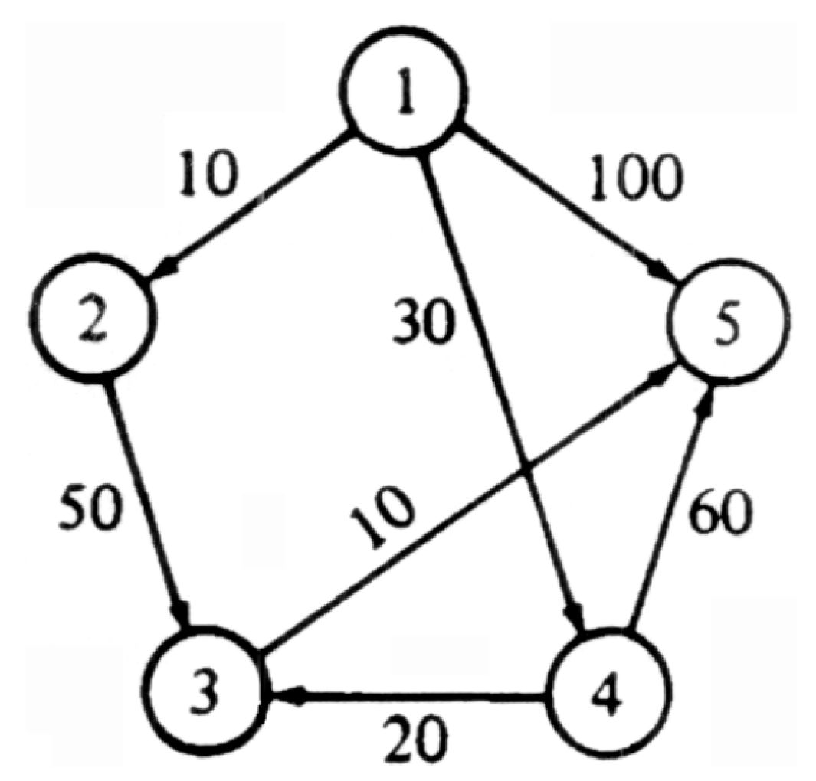
Example Graph

Slide 10
Example
Initially, S = {1}, D[2] = 10, D[3] = inf, D[4] = 30 and D[5] = 100
In the first iteration of the for loop of lines (4)-(8), w = 2 is selected as the vertex with the minimum D value
Then D[3] = min(inf, 10+50)= 60
D(4) and D(5) do not change, because reaching them from 1 directly is shorter than going through vertex 2

Slide 11
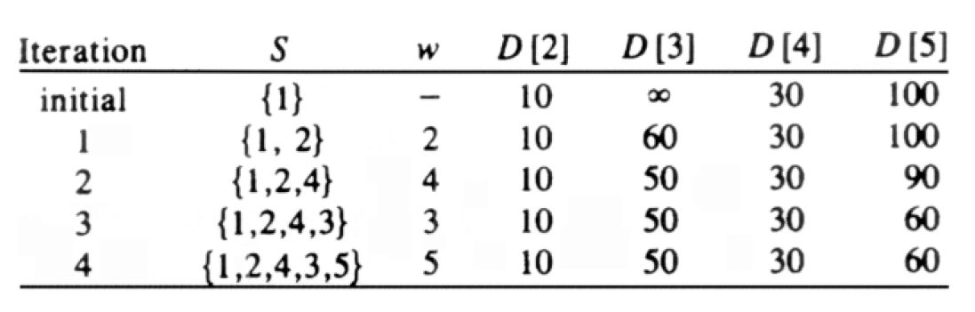
Algorithm Execution

Slide 12
Why Does It Work?
“Greed" pays off in that what appears locally as the best thing turns out to be the best over all
In this case, the locally "best" thing to do is to find the distance to the vertex w that is outside S but has the shortest special path
To see why in this case there cannot be a shorter nonspecial path from the source to w, observe:

Slide 13
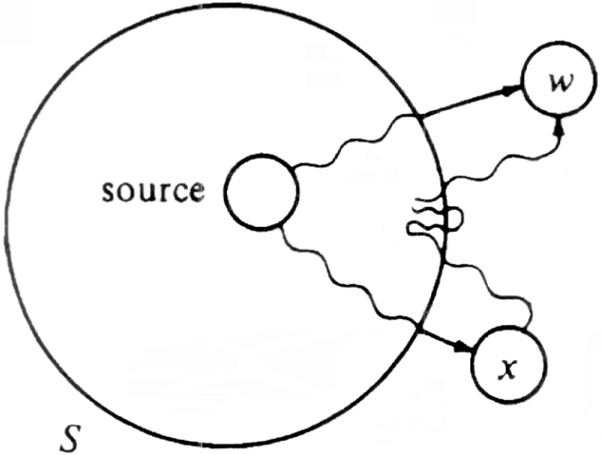
The Hypothetical Shorter Path
If path thru x is shorter than the shortest special path to w, then the initial segment of the path from the source to x is a special path to x is shorter than the shortest special path to w

Slide 14
Running Time
Digraph has n vertices and e edges
Using an adjacency matrix, loop of lines (7) and (8) takes O(n) time and is executed n-1 times for a total time of O(n²)
Rest of algorithm requires no more than this
If e is much less than n², use adjacency list and priority queue V-S
Lines (7) and (8) traverse the adjacency list for w and updating the distances in the priority queue
e updates will be made, each at a cost of O(logn) time, so the total time spent in lines (7) and (8) is now O(e logn)
Lines (1)-(3) clearly take O(n) time, as do lines (4) and (6)
Using the priority queue to represent V-S, lines (5)-(6) requires O(logn)
Total time is bounded by O(e logn)

